Slide 1
CS 540 Network Architecture
Lecture 20 : Named Data Networking
Prof. Younghee Lee

Slide 2
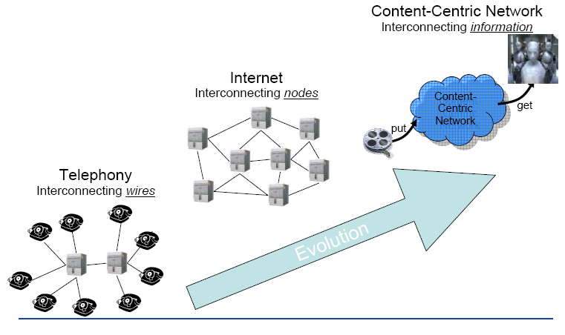
The third generation of networking
Find the path to destination => Find the path to content/service
T. Zahariadis et al., “Future Content-Centric Internet Architecture”, FIA 2009

Slide 3
Why do we need CCN in the Future Internet
Socio-economic aspect
Promotion of MM content creation environment, distribution
Innovative 3D video services
User generated content
Shared content
Interaction between cyber space and real space
Technology aspect
Video traffic explosion: 40% increase per year
Video traffic: 80% of future Internet traffic
Host centric : need to be free from mobility concern
Security: need to be free from the attack such as DDOS attack
Current Internet: Overlay Content Network
<= P2P, Media server, CDN, IPTV, (Smart TV?)
Scalability problem
Shortage of bandwidth, large delay
Pre-planned, application specific,

Slide 4
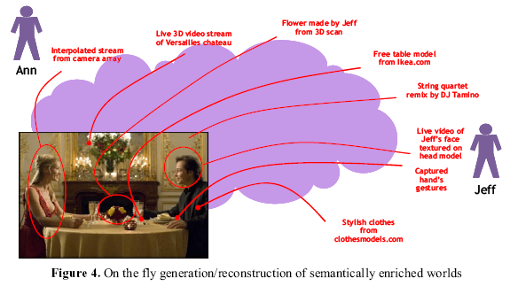
Real time Content/Media creation example
App for business/entertainment?
T. Zahariadis et al., “Toward a Content Centric Internet”, IOS press 2010

Slide 5

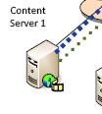
Efficient Internet architecture for Content/media?
Vinicio Vercellone, “Networking of Information: An information-centric approach to the network of the future”, ETSI Workshop Sophia Antipolis, March 2010

Slide 6
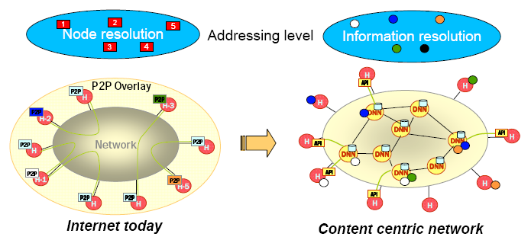

Efficient Internet architecture for Content/media?
Dissemination Network Node (DNN)
Content distribution: Common dissemination infrastructure for all applications
Augmented Internet – Real-world objects
– Linking real world objects in the virtual information world
T. Zahariadis et al., “Future Content-Centric Internet Architecture”, FIA 2009

Slide 7
Content-Centric Network : Architecture
e2e principle: retains or even expands this design principle
For robust applications in the face of network failures
Built-in security
Secured at the network layer
Routing and Forwarding plane separation
Routing plane can be evolved over time with the best available forwarding technology => research in parallel
Stateful forwarding
State of recently forwarded packets: caching, loop-detection, flow balance …
Communication driven by receivers (why?)
Sender need not to manage states

Slide 8
Content-Centric Network : Van Jacobson
Content traffic in 2008
500 exabyte (10¹⁸)
Networking with Named data
Rather than named hosts
Content chunk
simplicity in content routing
Simplified lower layer (L2)
Strategy: can select a optimum path according to the situation
Security: secure content itself (Signature)
Rather than secure connection
Broadcast
Multiple receivers can receive the content sharing the named data
Van Jacobson et al., “Networking Named Content”, CoNEXT 2009, Rome, Italy

Slide 9
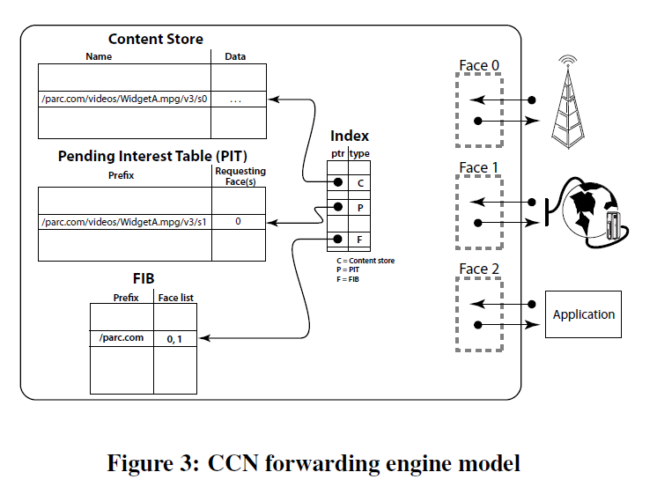
Content-Centric Network : Van Jacobson
FIB: Forwarding table, allows multiple output faces
Content Store: Buffer, also caches Data packets
(LRU or LFU replacement)
PIT: Pending Interest Table
Processing an Interest:
Matching Data is found in the Content Store => respond with a Data packet and consume Interest
Pending Interest in PIT => add this face to RequestingFaces list
keeps track of Interests forwarded upstream toward content source(s) so that returned Data can be sent downstream to its requester
Use FIB to forward Interest toward potential source(s) of matching data, add to PIT
Processing data
Data follows a chain if PIT entries back to the source
Van Jacobson et al., “Networking Named Content”, CoNEXT 2009, Rome, Italy

Slide 10
Content-Centric Network : Van Jacobson
Heirarchical content naming scheme
Longest match lookup
Transport
UDP
CCN Interests that are not satisfied in some reasonable period of time must be retransmitted
CCN Interests perform the same flow control and sequencing function as TCP ack packets
receiver’s strategy layer is responsible for retransmission on a particular face (since it knows the timeout for the upstream node(s) on the face) as well as selecting which and how many of the available communication interfaces to use for sending interests
Van Jacobson et al., “Networking Named Content”, CoNEXT 2009, Rome, Italy

Slide 11
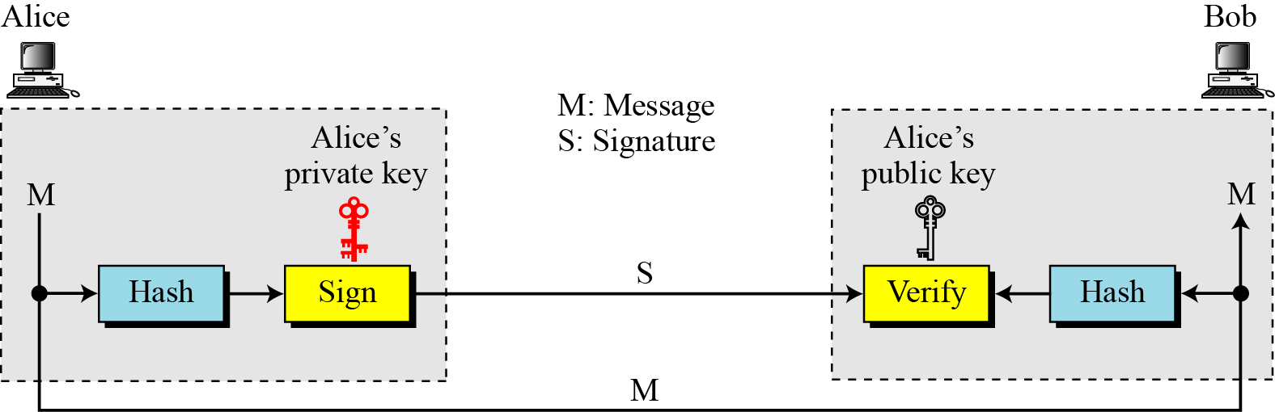
Securing Content, privacy
CCN trust establishment by associating content namespaces with public keys

Slide 12
Securing Content, privacy
Content Packet = 〈 name, data, signature 〉
Content
↕ Key
Name Hierarchy & Links
Content
↕ Key
Key Certification Graph
Content
↕ Key
Content
↕ Key
Content
↕ Key
Content
↕ Key
Lack of source addresses in NDN packets provide much better privacy than IP

Slide 13
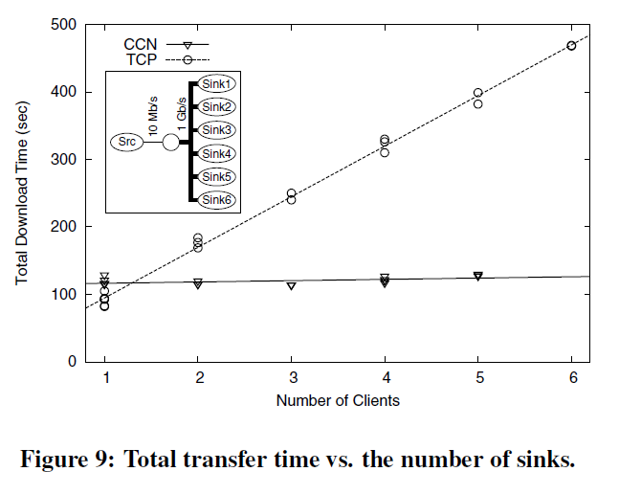
Content-Centric Network : evaluation
Van Jacobson et al., “Networking Named Content”, CoNEXT 2009, Rome, Italy

Slide 14






Distribution from end point communication
ISP
=>
ISP
ISP
ISP
+ Nothing associated with the communication changes with mobility.
* Some part of this teaching materials are prepared referencing the material presented at IEEE CCW Oct 10, 2011, www.named-data.net
Notes:
Current Internet architecture is communication- and comm. end-point-centric. But, the nature of the Internet shifted more towards content. Today’s Internet is radio-hostile; mobile-hostile; causes traffic concentration and congestion. It doesn’t deal well with distribution

Slide 15


Other applications in the works
Audio conferencing
Participatory sensing
Personal data cloud
Media distribution/streaming
VPN server/client
Network monitor/management tools
Pollution sources

Slide 16
NDN project
One of five on-going projects funded by the U.S. NSF under its Future Internet Architecture Program.: root => CCN
Open question
Key management
data authenticity, confidentiality and integrity : everything through key
Key are themselves named data
Key management: key distribution, key revocation
Robust and usable trust management
that allows content consumers to determine acceptable signing keys in a given context
Name space design
Self certifying names, which enable any node to verify that the name in a packet matches its content
Collaboration with social scientists

Slide 17
Comparison
Content Centric Networks
Naming: Hierarchical naming, single address
Security: Signed content
Routing: Longest prefix matching
Caching: Local or network based
Content existence knowledge: Not part of the CCN core
Producer-consumer meeting: Propagation of interests
Network of Information (Information centric network) (EU)
Naming: Flat naming
Security: Signed content
Routing: (1) Name resolution (2) Information transfer
Caching: Network based
Content existence knowledge: Through name resolution service
Producer-consumer meeting: Name resolution service provide locations

Slide 18
Flat name?
No hierarchy: no semantic meaning(just 160bit number)
No restriction to things for naming
No DNS-like politics
Need infrastructure for name resolution service
Not user-friendly in some sense
Locality
Performance: overhead,
Complexity: forwarding
Self-certifying naming
ID = Hash(Public Key)
Verify: Ownership without any infrastructure binding ID-> key

Slide 19
Appendix - early researches -

Slide 20
New Network Architecture
Current IP
network location + host identities
Separating them or Data oriented Networking
ILNPV6, HIP, i3, Layered naming architecture
ROFL: Route on Flat label
TRIAD
DONA
Content Based Network
….

Slide 21

ROFL: Routing on Flat Labels[2]
Flat host identifiers
No separate name resolution system required
DNS
Simple network configuration, allocation, mobility, multihoming….

Slide 22
Routing on Flat label?
Scalable routing without aggregation?
Flat label break aggregation
DHT for scalable routing?
Assumes point to point routing
Doesn’t support routing policies
Goal #1: Scale to Internet topologies
Mechanism: DHT-style routing, maintain source routes to successors/fingers
Goal #2: Support for BGP policies
Mechanism: Intelligently choose successors/fingers to conform to ISP relationships

Slide 23
ROFL
Self-certifying identifiers
Host’s or router’s identity
Tied to a public-private key pair
Identifier (ID) : a hash of its public key
Global ring
Each AS X runs its own ROFL-ring (RR)
Intradomain, Interdomain

Slide 24
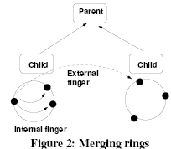
ROFL
Intradomain
Joining
Contacting hosting router
Chord-like joining algorithm
Return an ID’s predecessor ID and successor
Each ID has a source route to its successor and predecessor
Caching:
Routing
Greedy: in the direction of the pointer that is closest
Interdomain
Cannon-style recursive merging protocol

Slide 25
ROFL

Slide 26
ROFL
Policy support in ROFL
Isolation in ROFL (Canon)

Slide 27
Scalability in ROFL

Slide 28

ROFL
Performance?
tolerable
As lookup?
For content routing?
Just an idea?
Rolling On the Floor Laughing? (ROFL)

Slide 29
Layered Naming Architecture[1]
DNS: one level of name resolution
Propose: Three levels of name resolution
from user-level descriptors to service identifiers
from service identifiers to endpoint identifiers
from endpoint identifiers to IP addresses
To solve
Hosts are tied to IP addresses
Mobility and multi-homing pose problems
Services are tied to hosts
A service is more than just one host: replication, migration, composition
Packets might require processing at intermediaries before reaching destination
“Middleboxes” (NATs, firewalls, …)

Slide 30
Layered Naming Architecture
Name Services and Hosts Separately
Service identifiers (SIDs) are host-independent data names
End-point identifiers (EIDs) are location-independent host names
Protocols bind to names, and resolve them
Apps should use SIDs as data handles
Transport connections should bind to EIDs

Slide 31
Naming Layers

Slide 32
Flat names for SID and EID
Flat names impose no structure on entities
Flat names can be used to name anything
But
Global resolution infrastructure needed
Perhaps as “managed DHT” infrastructure
Lack of local name control
Lack of locality
Not user-friendly
User-level descriptors are human-friendly
0xf436f0ab527bac9e8b100afeff394300

Slide 33
Delegation
Packets might require processing at intermediaries before reaching destination

Slide 34
TRIAD[5]
The explicit inclusion of a content layer that provides scalable content routing, caching and content transformation
Extensible path-based addressing using this “shim” protocol on top of IPv4
TRIAD: acronym, standing for Translating Relaying Internet Architecture integrating Active Directory

Slide 35
TRIAD
Conventional Content routing
DNS or HTTP level redirection
Name lookup latency limits content transfer times as bw increase
P2P : proprietary solution
Caching
Cached data doesn’t reflect current topology

Slide 36
TRIAD
Content Router
Perform routing on names as part of a “content layer”
Perform DNS name request forwarding
Distribute name reachability information via name-based routing
Replica sites can be viewed as offering alternate routes to the sane content
Web server
user
ContentRouter
Web server
Content
Web server

Slide 37
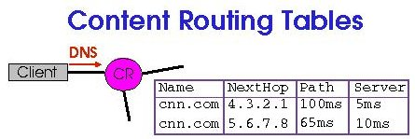
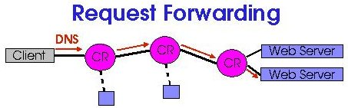
TRIAD
Content Routing Tables
Forwards requests to peer routers rather than remote servers
Routing decisions made with local state such as path latency, server latency, and topology
Request Forwarding
Last-hop CR returns address of server

Slide 38
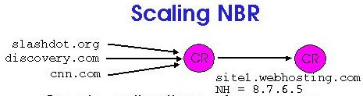
TRIAD
Name based Routing
Content routers exchange advertisements of preferred routes: name, next hop, path, latency
Servers advertise content, CRs push these advertisements outwards using BGP-like protocol
BGP with names
Scaling NBR
Create collections of names as “routing aggregates”

Slide 39
Data-Oriented Network Architecture (DONA): Problem [11]
Scott Shenker (M. Chowla, T. Koponen, K. Lakshminarayanan, A. Ramachandran, A. Tavakoli, I. Stoica)
Internet was designed for host-to-host communication
“contact this host...”
Internet is mainly used for data access
“get me this data.....”
Mismatch between usage and design:
data migration and replication unnecessarily hard
requires Akamai- and BitTorrent-like designs to scale
Question: what would the Internet look like if we designed it around data access?

Slide 40
Parents of this Work
Failure: ROFL
Mechanisms: HTTP, anycast, pub/sub, SFS, HIP,...
Architecture:
content routing:TRIAD
naming: LFN/DOA
no new ideas!

Slide 41
What Do Users Care About?
Persistence of names:
Follow data migration
Today: HTTP redirects, email forwarding
Availability of data: (both latency and reliability)
Take advantage of replicated data
Today: Akamai/BitTorrent
Authenticity of data:
Know that data came from intended source
Today: securing the channel (IPsec, TLS), or PKI

Slide 42
Current Barriers
Rigid and Weak Naming: hostname/path
Ties data to host, making migration/replication hard
Doesn’t help much with authentication
Protocol Mess: e.g., DNS, TCP, HTTP
Data isn’t named until the application is invoked
Caching (and other data handling) is application-specific
No low-level support for anycast-like service discovery

Slide 43
Fix #1: Flat, Self-certifying Names
Self-certifying (SFS, HIP)
Data associated with principal P with public key Kp
Names are of the form: Hash(Kp): label
Data requests return: <Kp, label, data, signature>
Can verify name related to Kp, and Kp signed data
Name not tied to location, so naming isn’t rigid
resolution mechanism described later

Slide 44
Fix #2: Better Protocol Structure
Implement replication and caching at lower level:
find closest replica without application-level tricks
caching infrastructure not application-specific
DONA does this through two major changes:
insert data-handling shim layer right above IP
resolve name by routing to data (TRIAD)
better fate sharing
less complicated management
No DNS, no lookup, just routing on names

Slide 45
Content based Networking
Applications
Distributed auction systems (e-Bay)
Information sharing systems (FastTrack, Gnutella)
Mobile and wireless applications (instant messaging, personalized news distribution)
Sensor network
New style of communication
The flow of information – from server to receiver
is determined by the specific interests of the receiver
not by explicit destination address of receiver: current IP based network
2016-11-27
45
Notes:
Content based networking is an emerging routing paradigm in that:
Message does not have explicit destination address, instead, content of message determines the destination implicitly.
45

Slide 46
Content based Networking
Multicasting as a Solution?
Multicast addresses = multicast groups: (unit: group of same interest)
Sender sends information to reserved address : SAP : announcement
Receiver “subscribes” for the address
Problem: How to split information into separate groups to satisfy all users?
Receiver must subscribe for a most of groups => huge unusable garbage
A lot of small groups? => sender must send to many groups & receiver must subscribe for many groups
Content based middleware as a solution
subscription can express predicates over the whole content of publication, not only over few well-known attributes
Advantage: Greater expressive power
Disadvantage: Scalability, not distributed but centralized
(Overlay network)
2016-11-27
46
Notes:
Content based networking is an emerging routing paradigm in that:
Message does not have explicit destination address, instead, content of message determines the destination implicitly.
46

Slide 47
Content based Networking
Still need addresses
associate predicates with their issuers
Maintain topological routing info
Predicate advertised by node is implicitly an address
Message set of typed attributes
2016-11-27
47
Notes:
Content based networking is an emerging routing paradigm in that:
Message does not have explicit destination address, instead, content of message determines the destination implicitly.
47

Slide 48
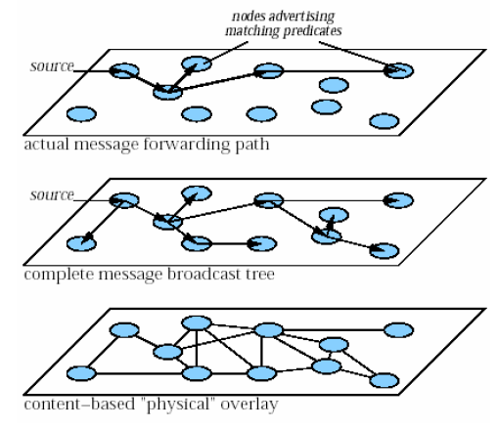
Content based Networking
Routing
Use advertised predicates to prune branches of broadcast distribution trees
Router uses 2 protocols
Broadcast routing
Content-based routing
“push” based on recv ads
“pull” based on snd requests
To update routing table
update replies
Avoids sending out ads that have already been set up
Use sender requests to collect routing info
2016-11-27
48
Notes:
Content based networking is an emerging routing paradigm in that:
Message does not have explicit destination address, instead, content of message determines the destination implicitly.
48

Slide 49
Content based Networking
Features
Receivers of message is dynamically determined by the content of message
Interest about “movie”
R
R
R
R
Message about “movie”
Interest about “movie”
R
R
2016-11-27
49
Notes:
Content based networking is an emerging routing paradigm in that:
Message does not have explicit destination address, instead, content of message determines the destination implicitly.
49

Slide 50
Content based Networking
Routing and Forwarding
Receiver registers its interest (predicate)
Routers exchange predicates with neighbors periodically
Advertised predicate is accumulated on each interface
Predicate about “Movie”
Predicate about “Movie”
Predicate about “Movie” or “Diet”
A sample form of predicate:
[Type = ‘Movie’ Λ Genre = ‘Horror’
Λ Size < 1GB]
I-1(P1)
R
R
R
A sample form of message:
[Type = ‘Movie’; Title = Spiderman;
Quality = High]
I-2(P2)
Predicate about “Diet”
Predicate about “Spiderman”
Notes:
50

Slide 51
Content based Networking
Open issues
Forwarding algorithm, forwarding table
Routing (how to update routing table, predicates changes very frequently)
Reliable Transport Layer
Security (privacy of receivers’ predicates)
Benchmarks
2016-11-27
51
Notes:
Content based networking is an emerging routing paradigm in that:
Message does not have explicit destination address, instead, content of message determines the destination implicitly.
51

Slide 52
Formalization of message model
Message consist of attributes
Attribute has
Type
Integer
String
Boolean
Name
Value
Example of datagrams:
[integer price = 18750, string stock = ‘INTC’]
[string city=‘Prague’, integer temperature = 25]
2016-11-27
52
Notes:
Content based networking is an emerging routing paradigm in that:
Message does not have explicit destination address, instead, content of message determines the destination implicitly.
52

Slide 53
Formalization of Predicate Model
Constraints on attributes
Integer
=, (≠), <, (≤), >, (≥)
String
Equality, (inequality), substring, prefix, suffix, <, (≤), >, (≥)
Boolean
=, (≠)
Filter = conjunction of constraints = predicate of the every receiver
Example of filter:
[integer price < 50 ∧ string stock = ‘MSFT’]
[alert-type=“intrusion” Λ severity>2 V class=“alert” Λ device-type=“web-server”]
2016-11-27
53
Notes:
Content based networking is an emerging routing paradigm in that:
Message does not have explicit destination address, instead, content of message determines the destination implicitly.
53

Slide 54
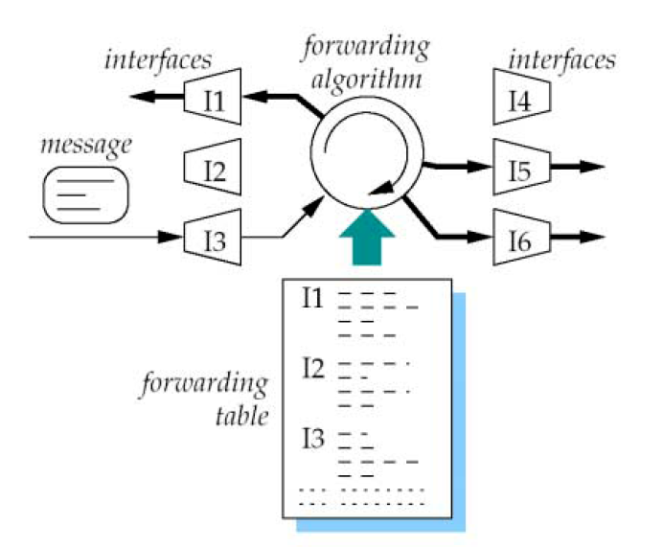
Forwarding in the CB-Network’s Router
2016-11-27
54
Notes:
Content based networking is an emerging routing paradigm in that:
Message does not have explicit destination address, instead, content of message determines the destination implicitly.
54

Slide 55
Example of Forwarding Table
Forwarding table one-to-one
association of predicates to
Interfaces
Filter
* conjunction of Constraints
* fs,t filter in disjunction of filters for
particular I
Is
* an interface
=> disjunction of Filters
Constraints in 3rd column
- Use counting algorithm to
determine which interface
predicate matches
2016-11-27
55
Notes:
Content based networking is an emerging routing paradigm in that:
Message does not have explicit destination address, instead, content of message determines the destination implicitly.
55

Slide 56
References
2016-11-27
ICE0602 Ubiquitous Networking
56
Hari Balakrishnan et al., “A Layered Naming Architecture for the Internet”, ACM SIGCOMM, Aug 2004
Matthew Caesar et al., “ROFL: Routing on Flat Labels”, ACM SIGCOMM SEP. 2006.
Mark Gritter et al., “An Architecture for Content Routing Support in the Internet”
Teemu Koponen et al., “A Data-Oriented (and Beyond) Network Architecture”, ACM SIGCOMM 07, Aug. 2007.
David R. Cheriton et al., “TRIAD: A New Next-Generation Internet Architecture”
Kevin Fall, “A Delay-Tolerant Network Architecture for challenged Internets” ACM SIGCOMM 03
Paul Francis, Ramakrishna Gummadi, “IPNL: A NAT-Extended Internet Architecture”, ACM SIGCOMM 01
Xiaowei Yang et al., “NIRA: A New Inter-Domain Routing Architecture”, IEEE/ACM Transaction on Networking 2007
Jing Su et al., “Haggle: Clean slate networking for mobile devices”, TR Cambridge University 2007
Sylvia Ratnasamy, et al., “Towards an Evolvable Internet Architecture”, ACM SIGCOMM 05
Scott Shenker et al., “Data Oriented Network Architecture: DONA”
Antonio Carzaniga et al., “A Routing Scheme for Content-Based Networking”
Notes:
56

